Slide 1

analysis AND gain a deeper understanding of polls and polling
Group-4 Presents
By:
David Cook-Francis
Grant Grossman
Aakash Rahman
David Debrowski
Michael Peyser
Trey Griffin

Slide 2
Proposal :
The goal of this data analysis is to gain a deeper understanding of polls and polling. We will then identify low quality and outlier polls and discard them utilizing statistical methods and the 538 Pollster Ratings.
Finally, we will analyze the data, build an aggregate of polls, and compare the predicted outcomes of polls with the final election results for the 2000, 2004, 2008, 2012, and 2016 elections. We will also posit what the 2020 presidential election polls might mean come November.
We will identify where polls have failed and offer suggestions that might make polls more accurate in the future.
Data Source:
https://rutsomdatapt0-x5y2373.slack.com/archives/G014NCJQCTD/p1594863197005300
https://elections.huffingtonpost.com/pollster/api/v2
https://github.com/huffpostdata/python-pollster

Slide 3
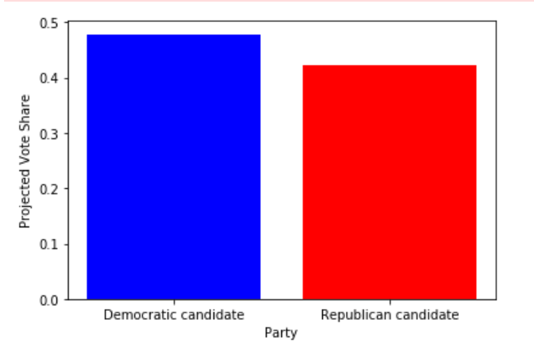
Party Vs Projected Vote Share

Slide 4
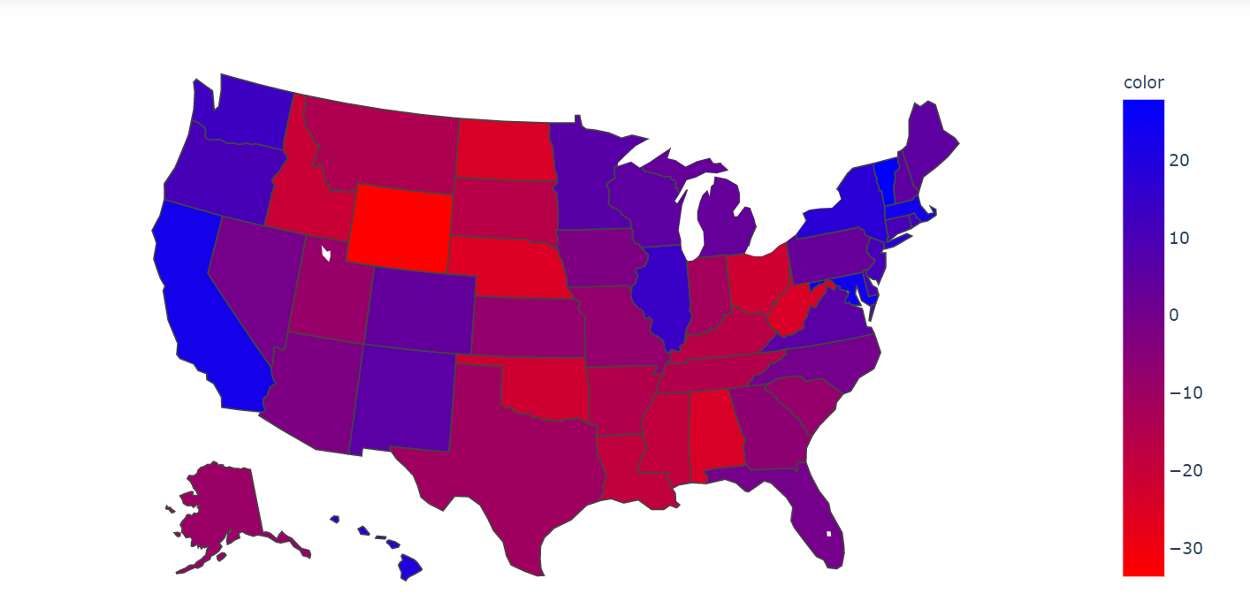

Slide 7

Summary of the Project:

